Slide 1
Computer Architecture
Lab 4

Slide 2
Part 1: ALU
- Types of ALU Micro-operations
- ALU Design
Part 2: Instruction Set Architecture
- MIPS Instruction Set Architecture

Slide 3
Part 1: Types of ALU Micro-operations
Types of ALU micro-operations
Data Transfer
Arithmetic
Logical
Shift
D ←A

Slide 4
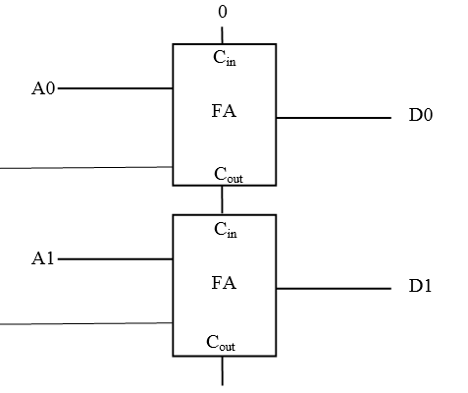
Part 1: Types of ALU Micro-operations (Arithmetic micro-operations)
Addition:
D ← A+ B
1
A 0011
+ B 0010
--------
D 0101
B0
B1

Slide 5
Part 1: Types of ALU Micro-operations (Arithmetic micro-operations)
0011
1’s complement 1100
+ 1
----------
1101
2’s complement, this is -3
Subtraction:
D ← A+ B’ + 1
1
5 0101
- 3 0011
--------
Has to be converted to 5+(-3).
We have to get negative representation of 3 by applying 2’s complement
B0
B1

Slide 6
Part 1: Types of ALU Micro-operations (Arithmetic micro-operations)
1
Increment:
D ← A+ 1
A 0011
0001
--------
D 0100
1
0
0
0

Slide 7
Part 1: Types of ALU Micro-operations (Arithmetic micro-operations)
1
Decrement:
D ← A - 1
A 0101
1111
--------
D 0100
1
0
0001
1110
+ 1
----------
1111
2’s complement OF 1 IS ALL ONES
1
1

Slide 8
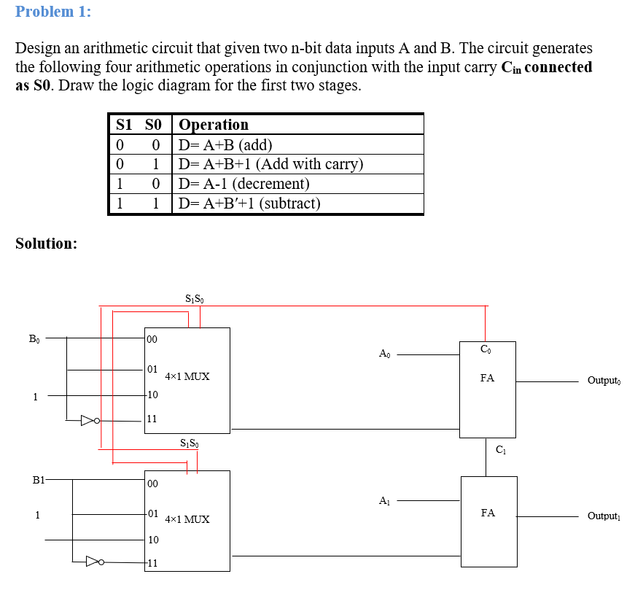

Slide 9
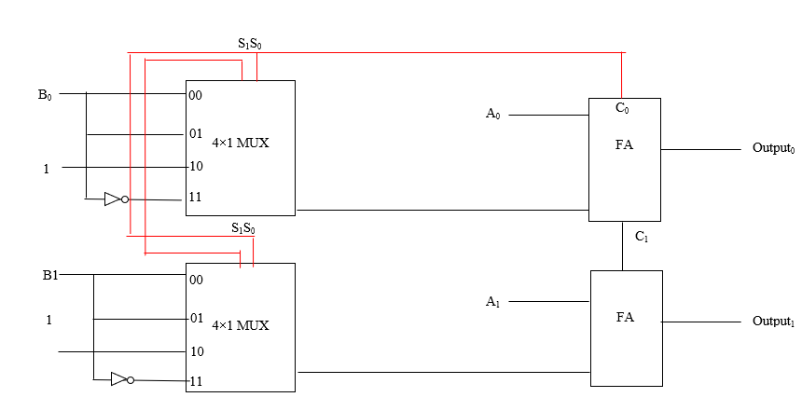

Slide 10
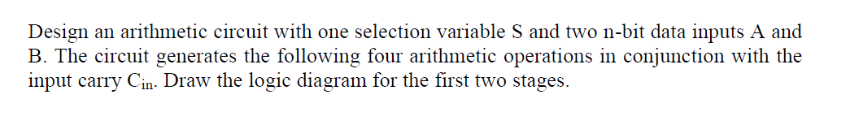
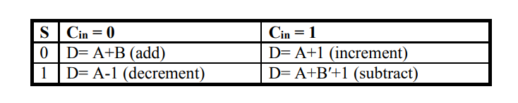
Part 1: Types of ALU Micro-operations (Arithmetic micro-operations)

Slide 11
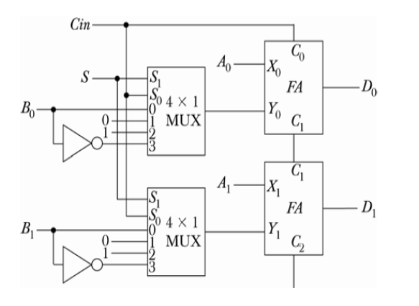
Solution:
S1 Cin
0 0 | D= A+B
0 1 | D = A+1
1 0 | D = A – 1
1 1 | D= A+ B’ +1

Slide 12
Solution:
S1 Cin
0 0 | D= A+B
0 1 | D = A+1
1 0 | D = A – 1
1 1 | D= A+ B’ +1

Slide 13
0
Solution:
c
0
S1 Cin
0 0 | D= A+B
0 1 | D = A+1
1 0 | D = A – 1
1 1 | D= A+ B’ +1

Slide 14
0
Solution:
c
0
S1 Cin
0 0 | D= A+B
0 1 | D = A+1
1 0 | D = A – 1
1 1 | D= A+ B’ +1

Slide 15
1
Solution:
c
0
S1 Cin
0 0 | D= A+B
0 1 | D = A+1
1 0 | D = A – 1
1 1 | D= A+ B’ +1

Slide 16
1
Solution:
c
0
S1 Cin
0 0 | D= A+B
0 1 | D = A+1
1 0 | D = A – 1
1 1 | D= A+ B’ +1

Slide 17
0
Solution:
c
1
S1 Cin
0 0 | D= A+B
0 1 | D = A+1
1 0 | D = A – 1
1 1 | D= A+ B’ +1

Slide 18
0
Solution:
c
1
S1 Cin
0 0 | D= A+B
0 1 | D = A+1
1 0 | D = A – 1
1 1 | D= A+ B’ +1

Slide 19
1
Solution:
c
1
S1 Cin
0 0 | D= A+B
0 1 | D = A+1
1 0 | D = A – 1
1 1 | D= A+ B’ +1

Slide 20
1
Solution:
c
1
S1 Cin
0 0 | D= A+B
0 1 | D = A+1
1 0 | D = A – 1
1 1 | D= A+ B’ +1

Slide 21
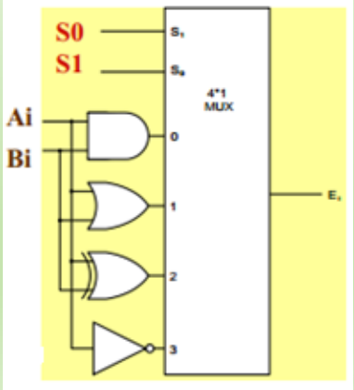
Logical Micro-operations
Four Logical operations
S1 S0
0 0 | D ← A ∧ B (And)
0 1 | D ← A ∨ B (OR)
1 0 | D ← A ⊕ B (XOR)
1 1 | D ← A’ (NOT)
A 0110
A 0110
A 0110
A 0110
∧
∨
⊕
B 0101
B 0101
B 0101
D 1001
D 0100
D 0111
D 0011

Slide 22

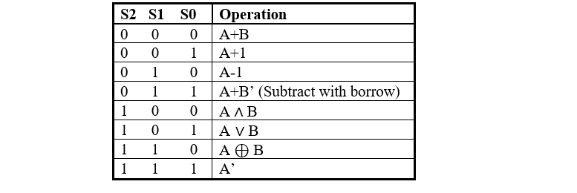

Slide 23
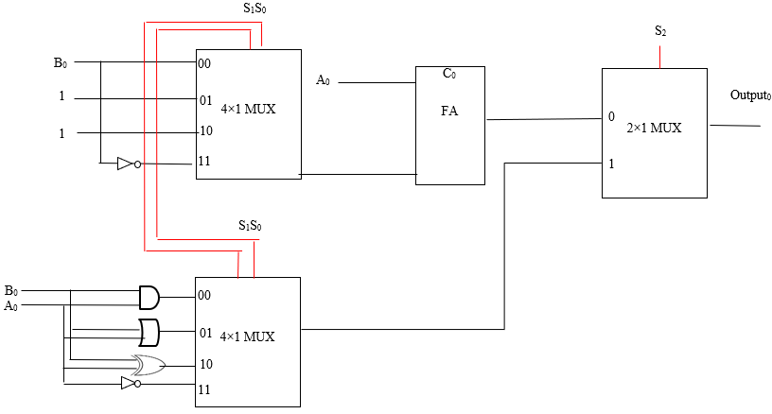
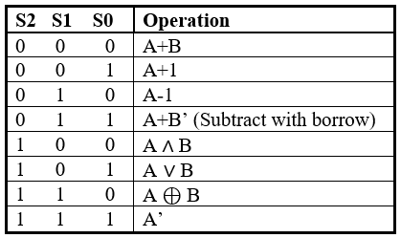
Arithmetic
Operations
logic
Operations

Slide 24
Arithmetic
Operations
logic
Operations

Slide 25
Arithmetic
Operations
logic
Operations

Slide 26
Part 2: Types of ALU Micro-operations
Types of ALU micro-operations
Data Transfer
Arithmetic
Logical
Shift
D ←A

Slide 27
Positive & Negative Values In Binary
Hexadecimal
A 3 9 B
F A C D
Positive Number
Negative Number
Binary
0101101110100101
1111101011001101
Most Significant Bit
Most Significant Bit
0 = Positive
1 = Negative
0 = Positive
1 = Negative

Slide 28
Part 1: Types of ALU Micro-operations
Shift
Micro-operations
Logical Shift left
Logical Shift right
Circulate left
Circulate right
Arithmetic Shift left
Arithmetic Shift right
Vs = Rn-1 ⊕ Rn-2
Vs =0
0100
Example1
0010
0100
0101
0101
0010
0100
0010
1010
1010
0100
0010
Example2
1010
1100
1100
1100
1010
1100
0100
Vs =1
1110
0110
1001
0110
0100
1 Shift left → multiply by 2 with unsigned numbers
1 Shift right→ divide by 2 with unsigned numbers
Can not solve the problem, but indicates overflow

Slide 29
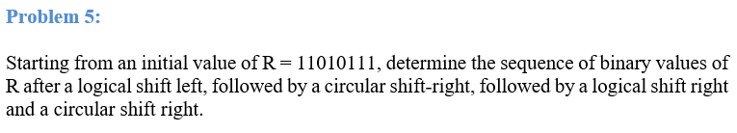
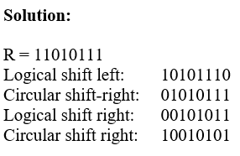

Slide 30
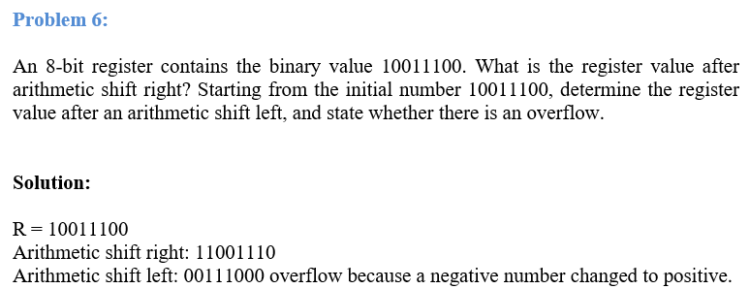

Slide 31
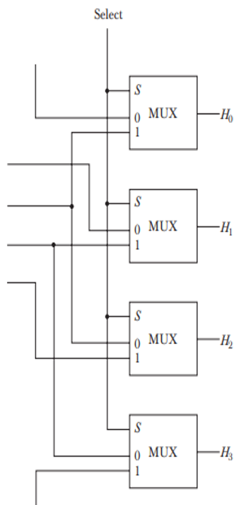
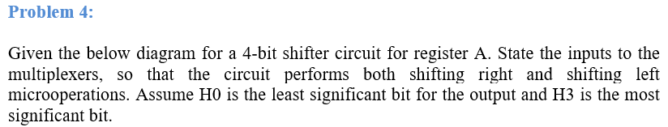

Slide 32
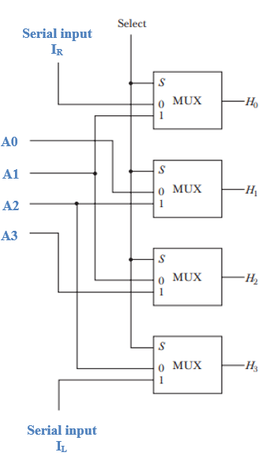
A3 A2 A1 A0
Logic Shift Left
A2 A1 A0 I
H3 H2 H1 H0

Slide 33
A3 A2 A1 A0
Logic Shift Right
I A3 A2 A1
H3 H2 H1 H0

Slide 34
Introduction to MIPS
It has 32 general-purpose registers.
Each register is 32 bits (from bit 0 to bit 31).
We will use from R16 to R23 to save the data.
R16 to R23 are named as S0-S7.
R0
32-bits
R1
32-bits
R31
32-bits

Slide 35
Introduction to MIPS
$S0
R16
$S1
R17
$S2
R18
$S3
R19
$S4
R20
$S5
R21
$S6
R22
$S7
R23

Slide 36
Memory in MIPS
Byte addressable Memory
Each address is 32 bits | 8 bits
 | 8 bits
 | 8 bits
 | 8 bits
 | 8 bits
 | 8 bits
So if a value in a register is stored in memory, it will take 4 cells

Slide 37
Data Transfer Instructions (load immediate and move)
s0 = R16
$s0 is destination register and 3 is an immediate value
li $s0,3
3
li $s1,5
$s1 is destination register and 5 is an immediate value
s1 = R17
5
move $s2, $s0
Copy the value in $s0 to $s2
s2
3

Slide 38
Arithmetic Instructions (Add, Add Immediate, subtract)
s1 = R17
$s1 is destination register that has the result of $s2+$s3
add $s1,$s2,$s3
5
addi $s1,$s2,100
$s1 is destination register that has the result of $s2+100
s2 = R18
2
sub $s1,$s2,$s3
$s1 is destination register that has the result of $s2-$s3
s3 = R19
3

Slide 39
First Program in MIPS
s1 = R17
.globl main
.text
main:
li $s0,2
li $s1,3
li $s2,0
add $s2,$s0,$s1
li $v0,10
syscall
3
Start of the code
s2 = R18
2
s3 = R19
End of the code
5
Notes:
The instruction letters all small letters

